Slide 1
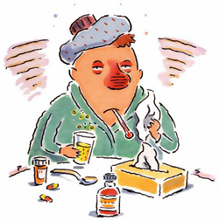
Environmental Health
Biological Hazards

Slide 2
Common Hazards
Heart disease → 271.0
Motor vehicle accidents → 15.0
Falls → 6.0
Illegal drugs → 5.6
Being hit by a meteorite → 0.04
Lightning → 0.016
*expressed as: annual risk of death per 100,000 people*

Slide 3
Environmental Health
Study of how environmental “factors” affect human health and our quality of life
  factors: natural & human-made
Factors that threaten/harm humans = hazards
  Biological, social, chemical, physical

Slide 4

Hazards
Social/Cultural
  Result from where we live, our jobs, and/or lifestyle choices
  Ex: smoking, release of chemical(s) from nearby factories, poor diet, poverty, unsafe sex
Notes:
Emissions, residuals

Slide 5

Hazards
Chemical
  Released into: air, water, soil, food
  Synthetic chemicals
  Disinfectants
Refer to
ppt project*
Notes:
Emissions, residuals

Slide 6
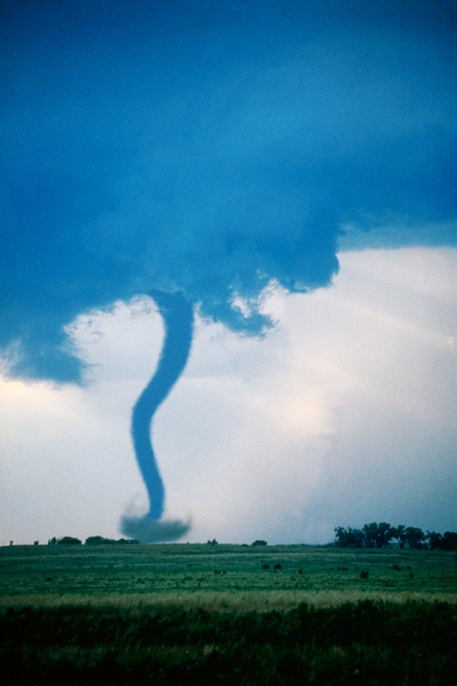
Hazards
Physical
  Natural disasters, ongoing natural phenomena (UV radiation)
Biological
  Result from pathogens (viruses or bacteria)
Notes:
Emissions, residuals

Slide 7
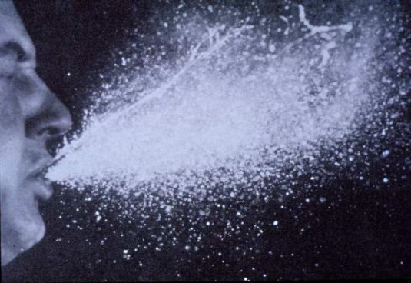
What causes disease?
Infectious agents (pathogens) that spread by:
  Air
  Water
  Food
  Bodily fluids
  Vectors (nonhuman carriers, like mosquitoes)

Slide 8
Transmissible vs.
Nontransmissible Diseases
Transmissible: caused by living organisms and can spread from person to person (bacteria, virus, parasite, etc.)
Nontransmissible: caused by something other than a living organism and does not spread from person to person (cancer, diabetes, etc.)

Slide 9
Seven Deadly Diseases
90% of all infectious disease deaths are caused by:
  Pneumonia/flu
  HIV/AIDS
  Diarrheal disease
  TB
  Malaria
  Hepatitis B
  Measles

Slide 10
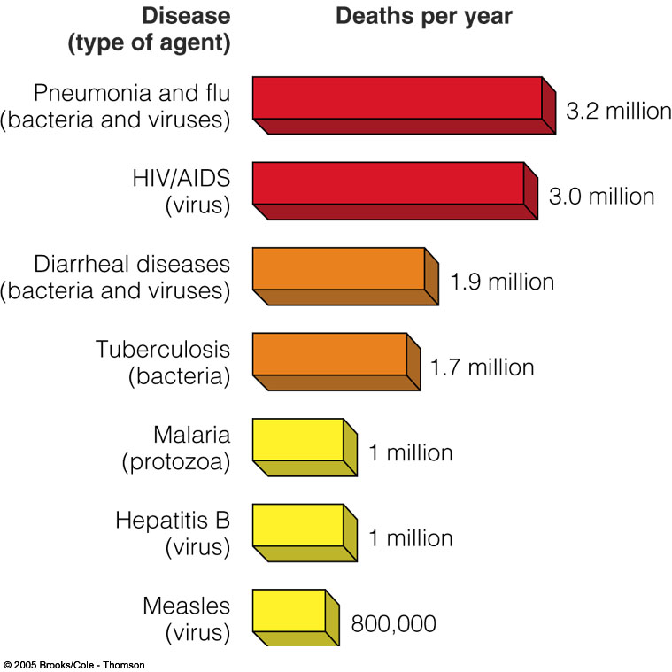

Slide 11
Emerging Diseases
Disease appearing for the first time OR increasing/spreading rapidly around world
These pathogens are extremely dangerous – no resistance, no vaccinations, etc.
Ex: H1N1 (Swine flu) →
  March 2009 found in Mexico
  June 2009 found in 70+ nations – 30,000 ppl infected
  Would this be an endemic? Epidemic? Pandemic?

Slide 12
Spread of Emerging Diseases
Increasing mobility – ex: flying across borders w/influenza
Antibiotic resistance – diseases becoming resistant to medicine
Changing environment – climate: if global temperatures continue to rise, tropical diseases (malaria, cholera) may spread

Slide 13
http://evolution.berkeley.edu/evolibrary/home.php
Life Sciences-HHMI Outreach. Copyright 2006 President and Fellows of Harvard College.

Slide 14
Responding to Emerging Diseases
International → World Health Organization (WHO) – when emerging disease is identified, WHO posts info on web
National → Centers for Disease Control & Prevention (CDC) – primary national center for responding to emerging diseases in US

Slide 15
Staggering Statistics
13 million people die each year from infectious diseases
Within the next hour, 1500 people (1/2 under 5 years old) will die from an infectious disease
A child born in a developing country has a 1000 x’s greater chance of dying from measles than one born in an industrialized country

Slide 16


Low Cost Disease Prevention
Childhood vaccinations
Mosquito bed nets
Inexpensive drugs
Access to contraceptives
Vitamin and mineral supplements
Education
Good hygiene

Slide 17
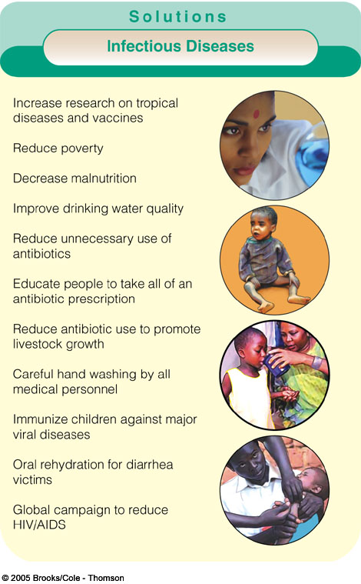

Slide 18

Nonfatal Effects of Disease
Health care expenses
Inability to go to work/school
Body deformities (open sores, loss of extremities, grotesque swelling)
Excruciating pain
Social stigmatization
Emotional stress

Slide 19
Disease Distribution
Are these infectious diseases distributed equally throughout the world?

Slide 20
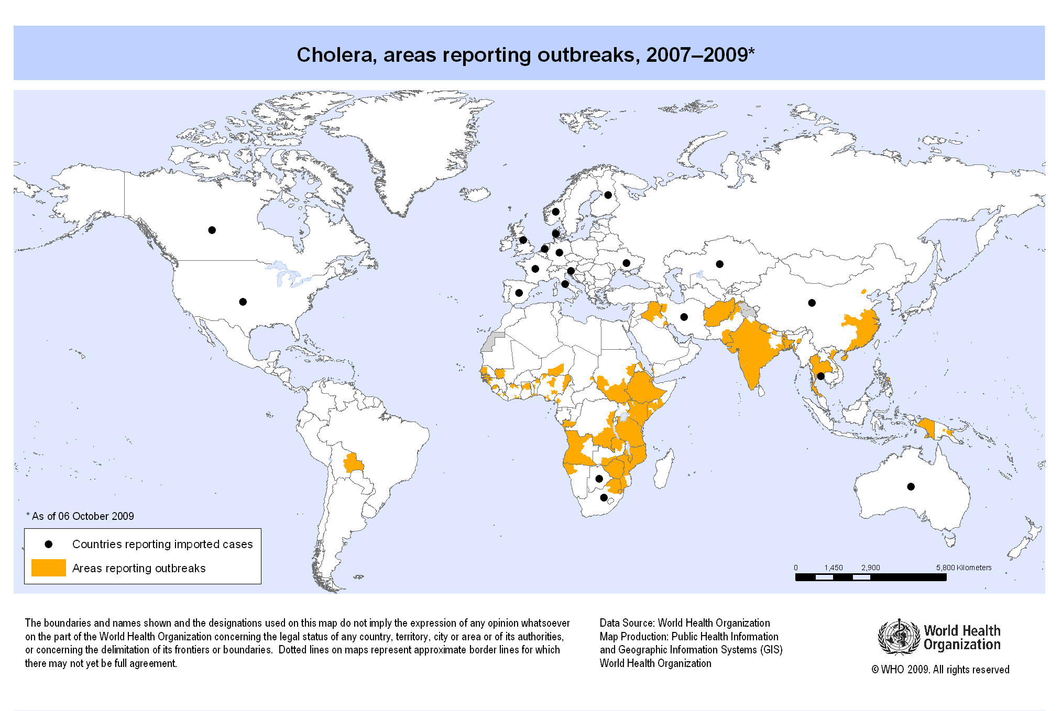

Slide 21
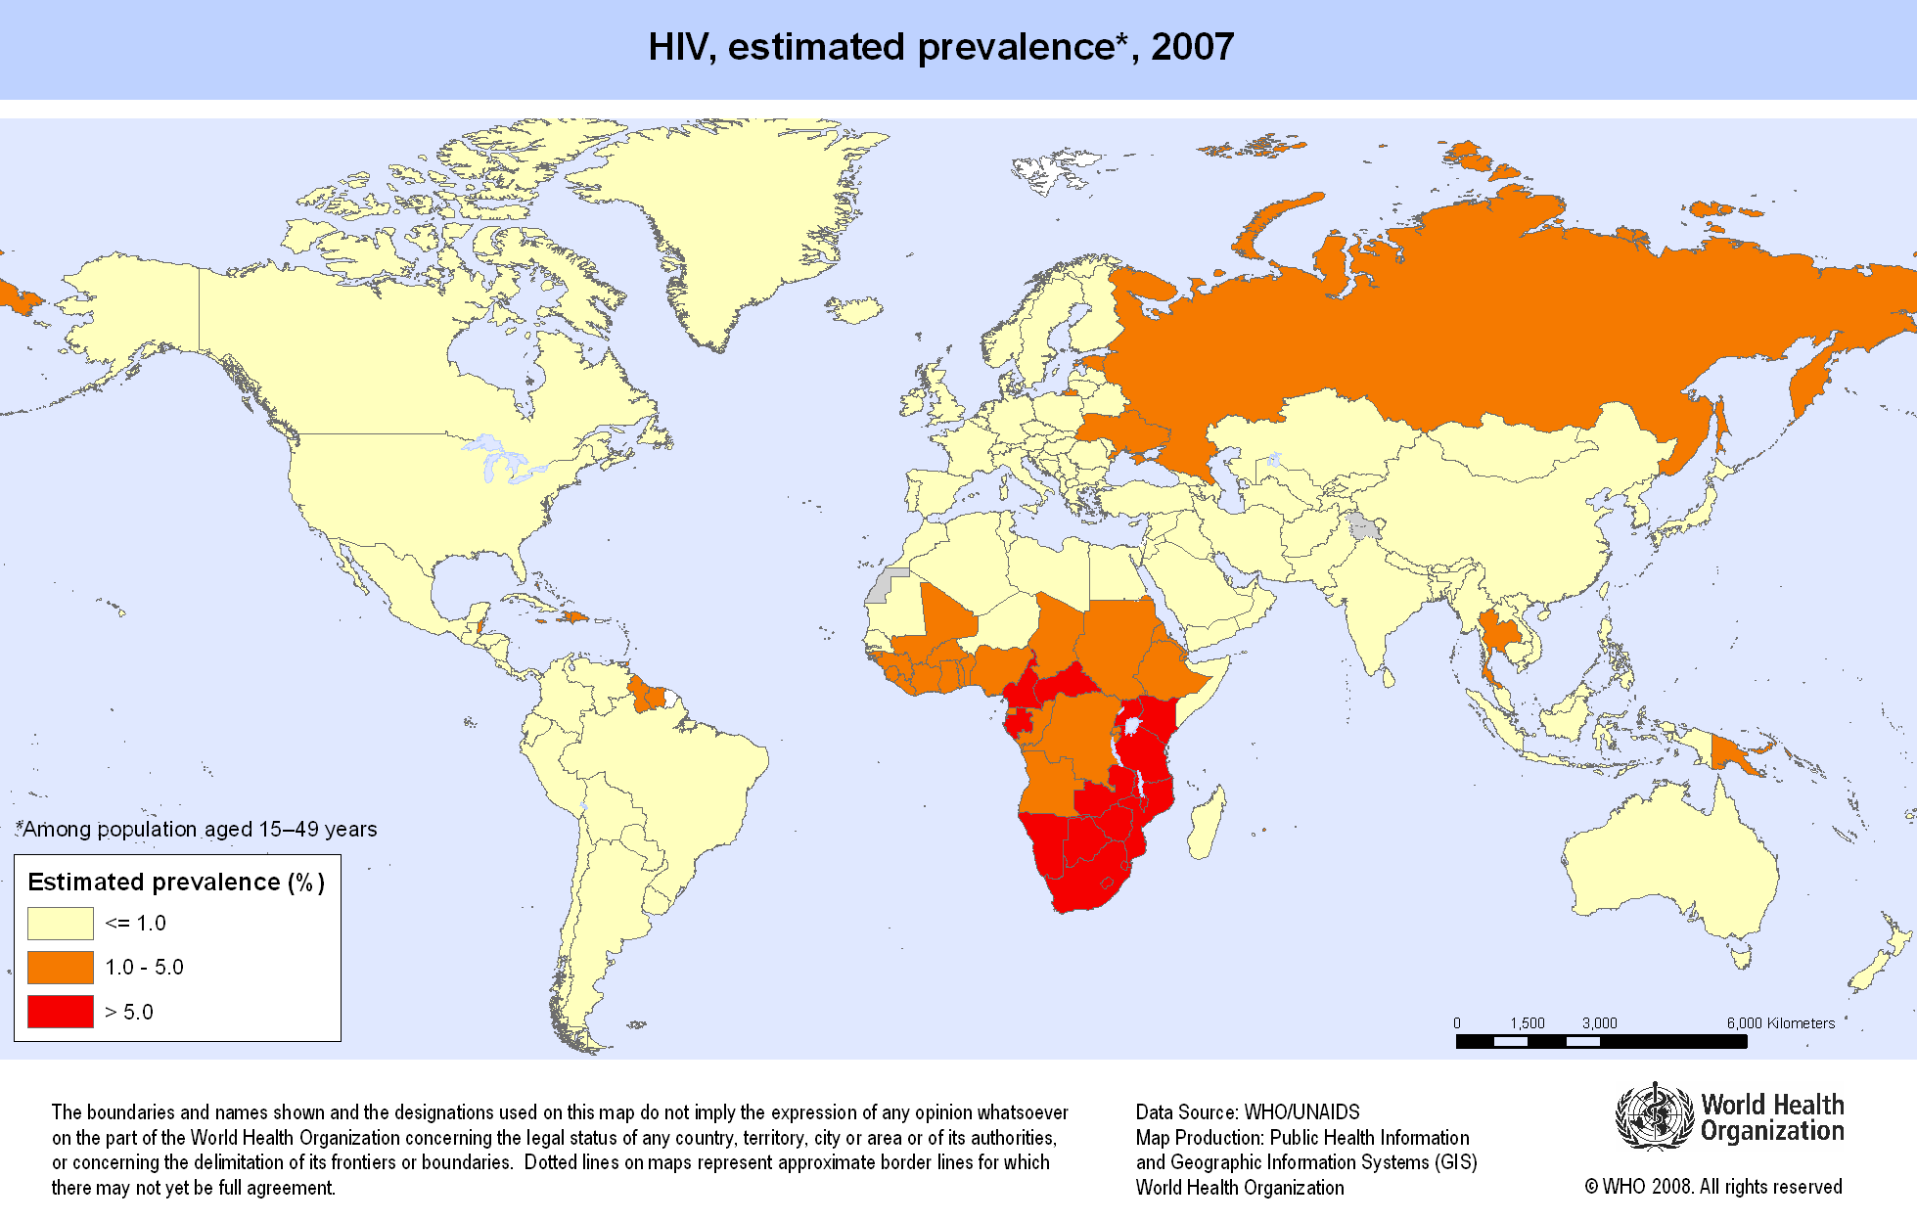

Slide 22
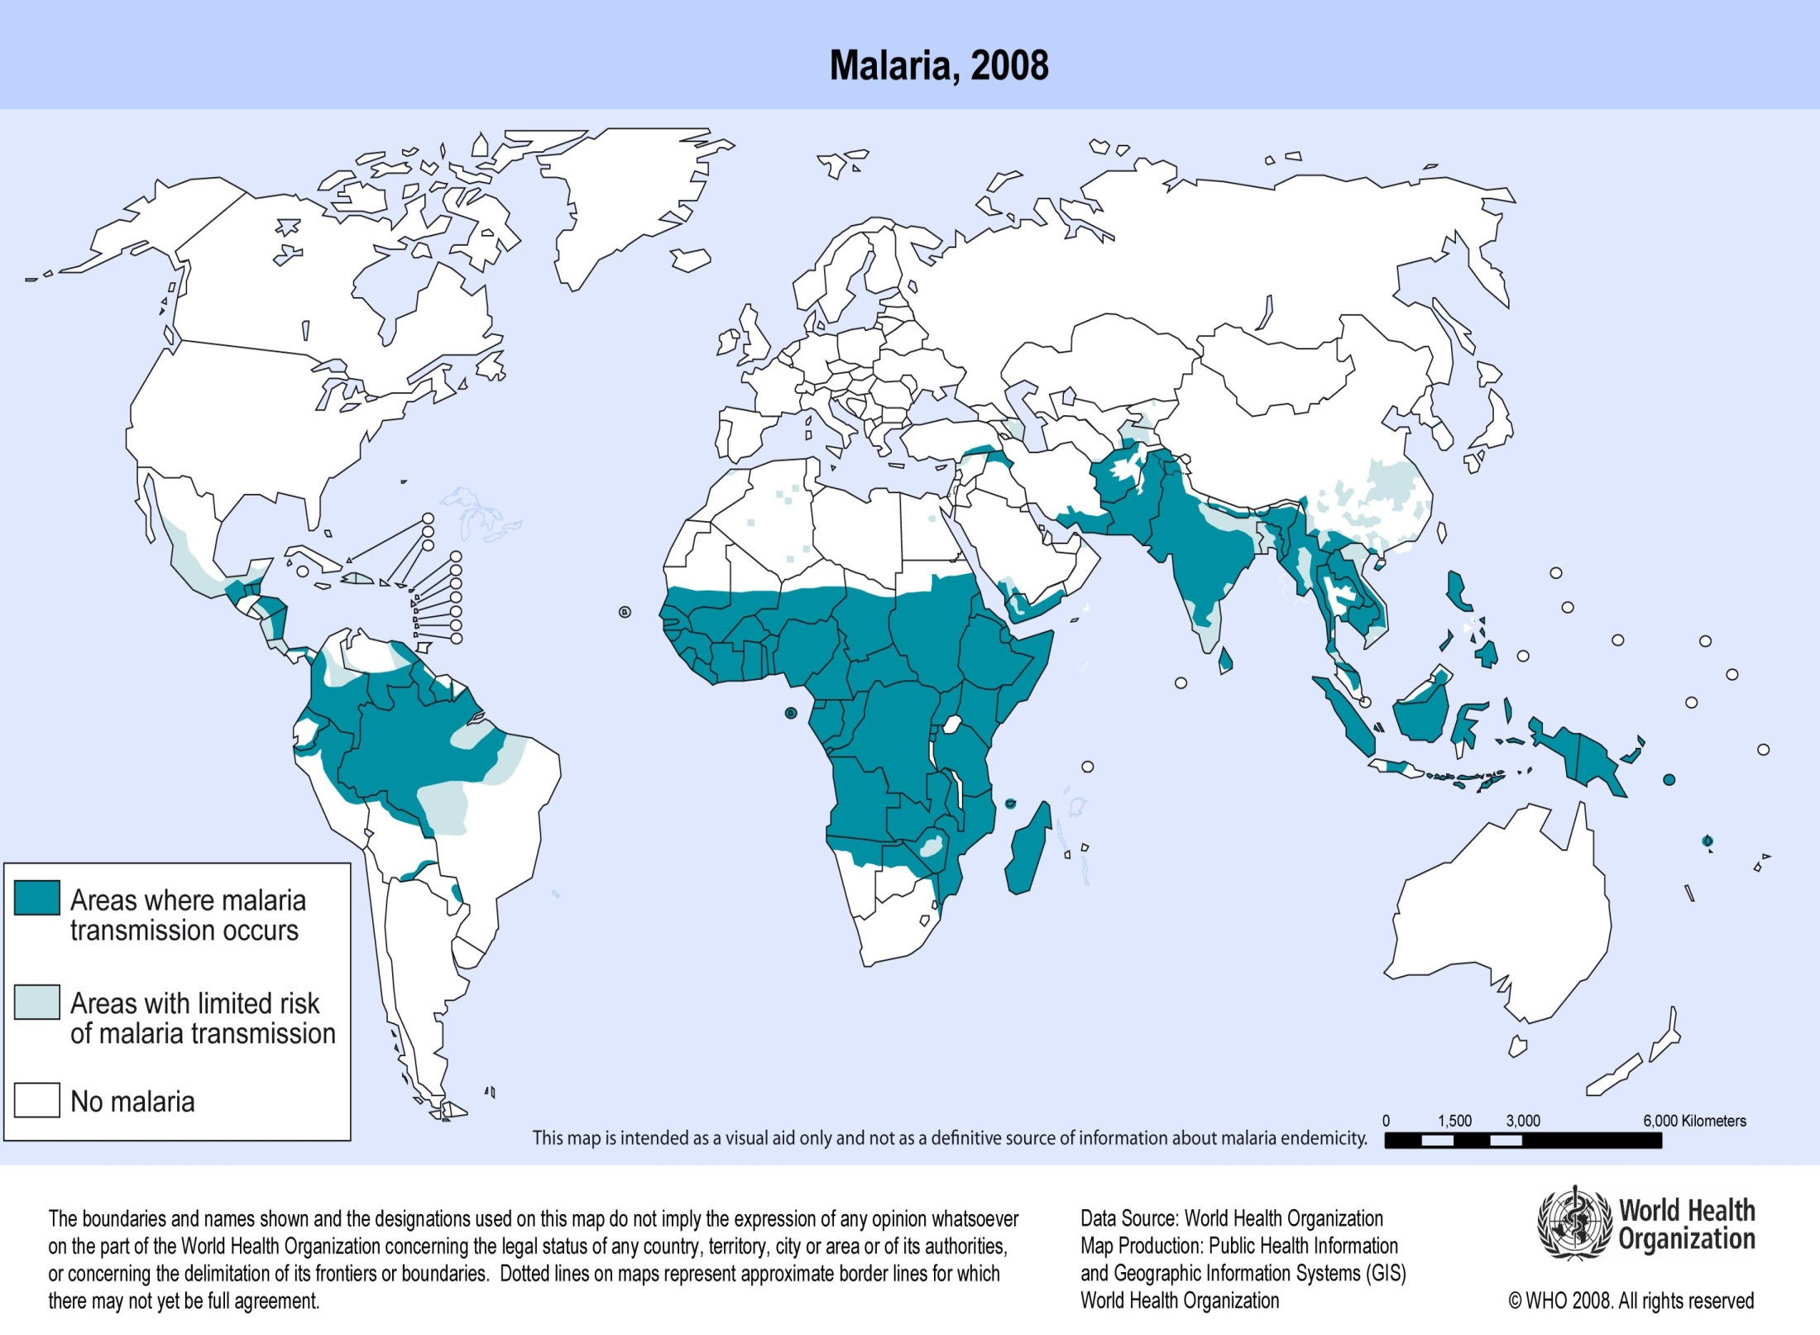
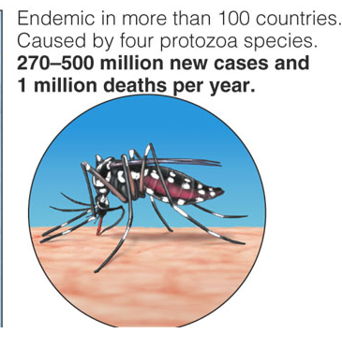

Slide 23
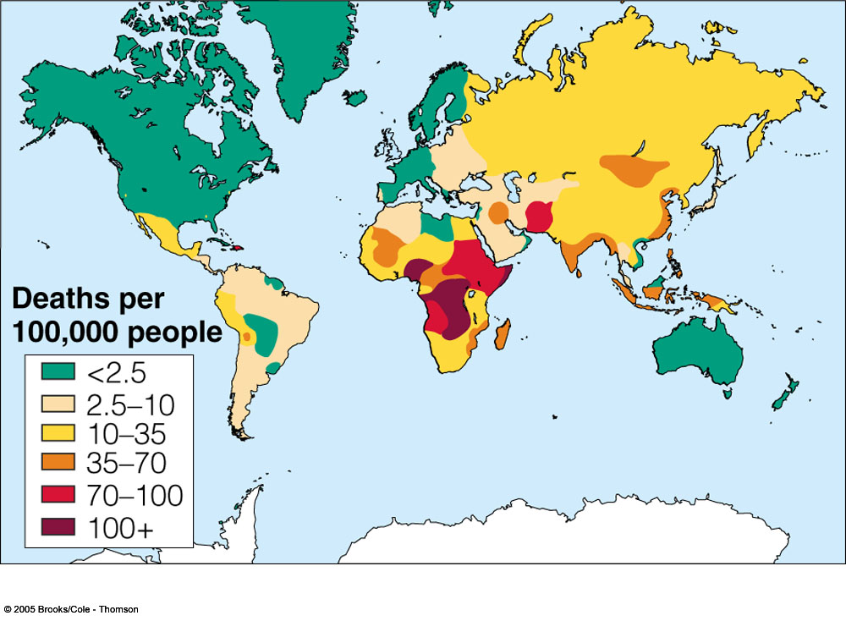
TB Kills 1.7 million people per year.

Slide 24
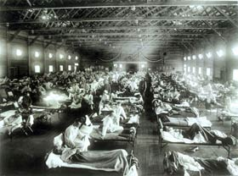
Transmissible Diseases
Good News: Since 1950, death rates fallen dramatically
Bad News: Bacteria resistance growing and insects becoming immune to pesticides

Slide 25
Epidemiology
Study of disease in human populations
Epidemiologists study how/where diseases occur and how to control them

Slide 26
Toxicology
Study of how poisonous substances affect an organism’s health
Substances toxicity determines how harmful a substance is to an organism
Depends on..
  1) actual substance
  2) how much of the substance is needed to cause harm

Slide 27
Toxicology
Dose-Response Relationship – determines toxicity by measuring the response a substance produces at different doses
Dose = amount of substance an organism is exposed to/found in body
  * BOTH concentration of substance and exposure time
  Can be: ingested, inhaled, injected, absorbed
“The dose makes the poison”
Response = effect an organism show as a result of exposure

Slide 28
Sensitivity to Toxins
Amount of damage (response) is related to the dose you get
Response is related to age, gender, weight, and genetic makeup

Slide 29
Toxicology
Solubility - what can the chemical dissolve in?
  Water-soluble toxins
  Oil/Fat-soluble toxins
Which do you think is generally “better” for the health of an organism?
  Water is “better” since it can be diluted
  Fats aren’t good since chemicals can gather in body fat of animals

Slide 30
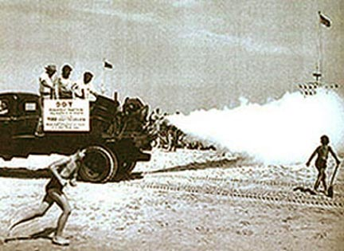
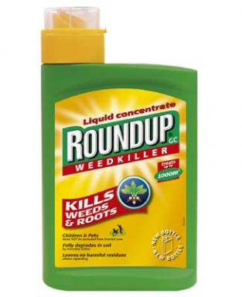
Toxicology
Persistence - how long a chemical stays in the environment
  Roundup (kills plants) breaks down in 24 h when exposed to light
  DDT (kills insects) breaks down in 2 to 15 years

Slide 31

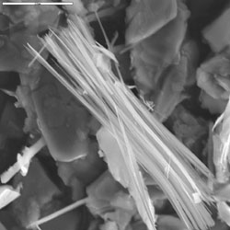

Toxicology
Chemical interactions - two (or more) factors together can have a greater effect than each by themselves
  Being exposed to asbestos (insulation) and smoking give you a 400 times greater chance of lung cancer
+
=

Slide 32
Dose-Response Relationship
Threshold dose = when response only occurs above a certain dose
When below “threshold dose,” body can break down the substance
Hard to determine – people may have been exposed w/o knowing, etc.
Animals are used as test subjects for dose-response relationships

Slide 33
Dose-Response Relationship
Will an organism always have the same response to a chemical regardless of the dose it is exposed to?
No! Response varies with the dose
High doses may kill an organism,
while low doses may make organism sick

Slide 34
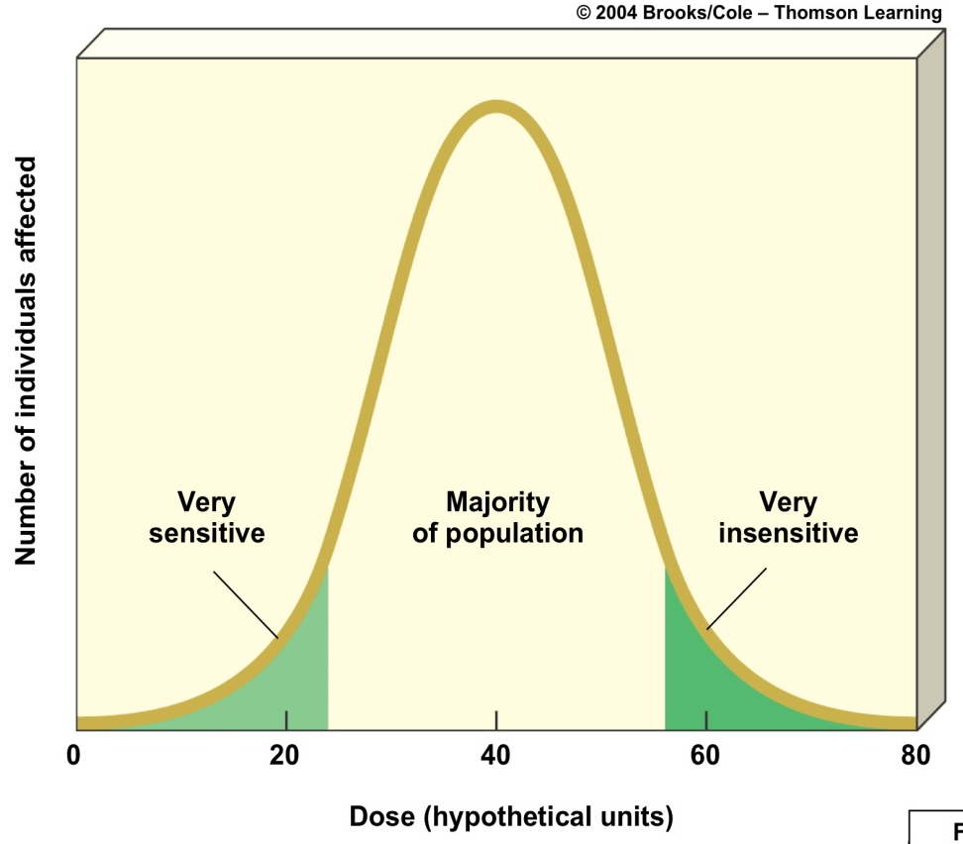
Dose-Response Curve
HW: Animal testing is often used to determine the toxicity of a substance. Do you think it is ethical to use animals in this way? Why or why not?

Slide 35
Risk Assessment
Exposure to environmental hazard doesn’t always cause harm – “produce a response”
Risk assessment = Process of measuring risk

Slide 36
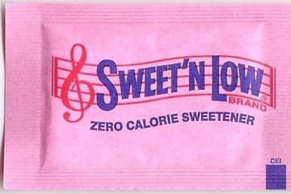

Toxicity Assessment
An interesting animal study concerning the artificial sweetener saccharin
Animal studies indicated that saccharine caused bladder cancer in animals. In 1977, the FDA proposed a ban on its use.
Studies later reveled that the doses given to animals were the equivalent of a human drinking 100 cans of soda a day. Human tests never linked saccharine to human cancer because the way that saccharine gave cancer to rats does not happen in humans.
Saccharine was taken off the FDA’s possible cancer list in 2000, after 25 years of needless worry.
Worry is still around today.

Slide 37
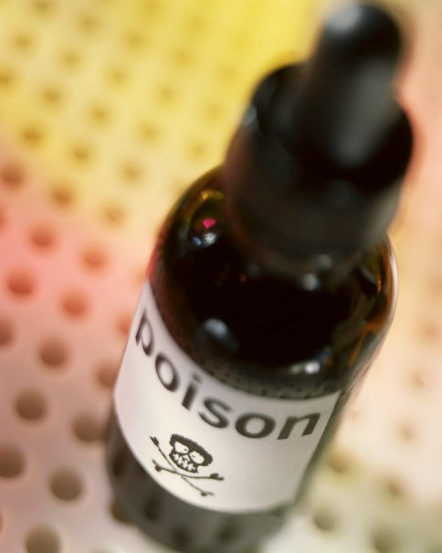
Toxicity Assessment - Poisons
Poisons – materials that kill at a very small dose (50 milligrams or less per kilogram of weight)
The LD₅₀ (lethal dose) is the amount that kills 50% of a test population in a given time.

Slide 38
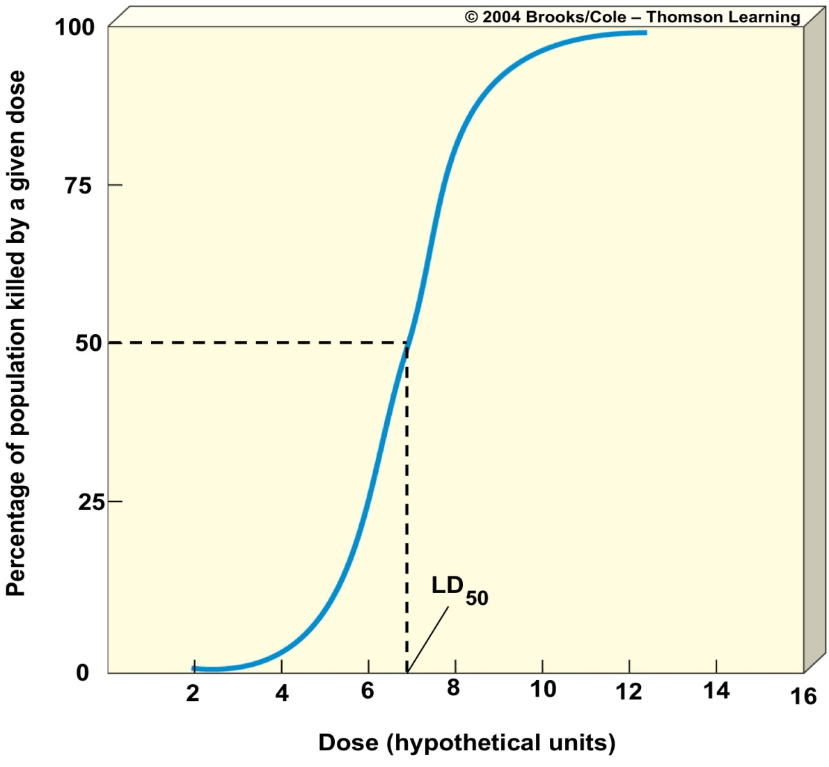
Toxicity Assessment -Poisons
The LD₅₀ of this chemical is 7.
Look along the blue curve. The dose that kills 50% is the LD₅₀.

Slide 39
STEPS TO MEASURE RISK
Toxicity Ratings

Slide 41
Risk Assessment vs. Risk Management
Risk Assessment “What is the hazard?”
Risk Management “How can the risk be minimized?”

Slide 42

What is risk?
Risk = probability that a hazard will cause a harmful response

Slide 43
STEPS TO MEASURE RISK
1. Problem Identification
Scientific or public concerns about harm from a particular substance often initiate the problem identification process.
Evidence is gathered by:
  Animal studies
  Test tube studies
  Comparison studies – the properties of the substance are compared with substances known to be harmful.

Slide 44
STEPS TO MEASURE RISK
2. Exposure Assessment
Estimates how much of a substance a population inhales, ingests, or absorbs through the skin (aka the “dose”)
Some of the factors we must consider are:
  How long people have been exposed
  Whether the exposure was continuous or intermittent
  How they were exposed – inhalation, ingestion, or absorption through the skin

Slide 45
STEPS TO MEASURE RISK
3. Toxicity Assessment
Toxicity assessments estimate how much of a substance does what kind of harm
The toxicity assessment step looks at how much of a substance causes what kind of harm to humans.
Toxicity to humans is not usually measured directly by intentionally exposing people, for obvious ethical reasons.

