Slide 1
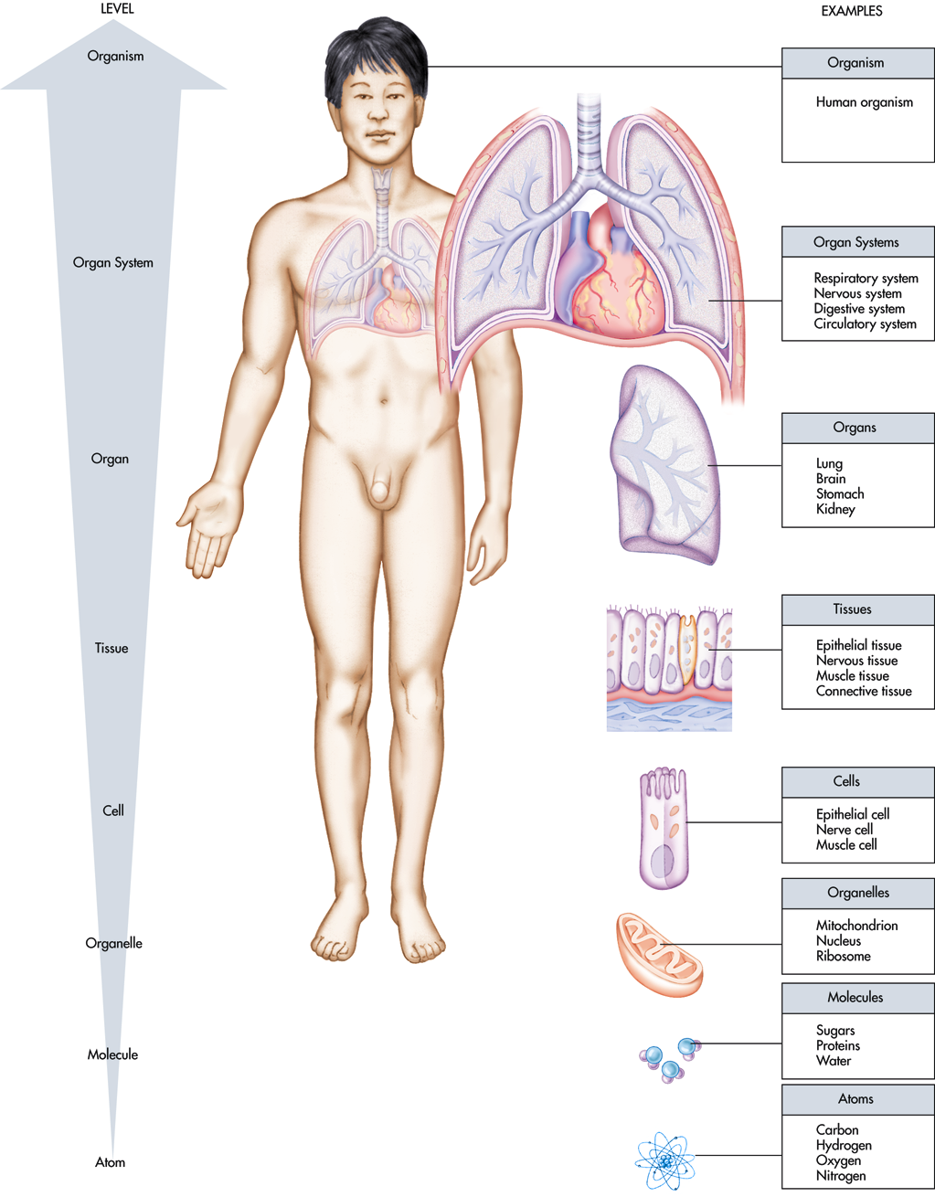
The human body:
Levels of Organization

Slide 2
Levels of Structural Organization
Chemical – atoms combine to form molecules
Cellular – molecules interact to make up cells
Tissue – cells are grouped into tissue
Organ – tissues compose organs
Organ system – organs function together to form organ systems
Organism (individual) – made up of the organ systems

Slide 3
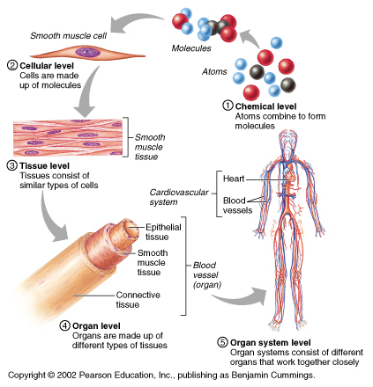
Levels of Structural Organization
1.Chemical
Atoms
Molecule
2.Cell
3.Tissue
4.Organ
5.Organ System
Organism

Slide 4
The Characteristics of Life
Organization:
Made up of cells
Stable structures that make it possible for cell to perform fxns
Movement:
constant moving of substances in & around cells
Transport vita/minerals (O2/nutrients) to cells
Transport wastes (CO2/urea) away from cells to other organs for processing
Cells move (WBC, muscles, etc.)
Internal organs move substances
Blood moves via vessels
Organism moves to change position in space
Responsiveness/Excitability: capability of cell to sense changes/stimuli and produce a response (ex. change in temp., change in pressure, change in pH, etc.)
Stimuli = changes that influence cells

Slide 5
The Characteristics of Life (cont.)
Growth and Reproduction:
cell increase in size as result of anabolic activity
Ex: hypertrophy – cells that have grown large
(more) (feeding)
Process of making offspring
Metabolism: the sum of all chemical reactions that occur in the body; obtainment and usage of energy
2 categories: Anabolism (build up) & Catabolism (break down)
** will come back to metabolism **

Slide 6
Review: Characteristics of Life Hand on Hot Stove Example
Page 256 in textbook
Organization
Metabolism
Movement
Excitability
Growth and reproduction

Slide 7
Metabolism
A broad term used for all the chemical
reactions that occur within cells of the body
Catabolism - breaking down substances into
simpler components for the release of energy
Anabolism – synthesizing more complex
substances or structures from simpler substances;
process of growth and repair.

Slide 8
Metabolism
Dehydration Synthesis: Anabolism (builds up)
Small organic molecules are joined to form a macromolecule and a water molecule is given off.
Hydrolysis: Catabolism (breaks down)
Macromolecules are broken down into small organic molecules by the addition of water.

Slide 9
Metabolism
The substances being metabolized are
Macromolecules/Organic Compounds
Name Building Blocks_____
Carbohydrates monosaccharides
Lipids/Fats 1 glycerol & 3 fatty acids
Proteins amino acids
Nucleic Acids nucleotides
(DNA & RNA)

Slide 10
Metabolism
Dehydration Synthesis →
(Lose H2O) (build/production of bonds – energy absorbed)
H2O – product
Anabolism/synthesis: A + B → AB
+ + H2O
H+ OH-
Hydrolysis →
(Add H2O) (break apart bonds – energy released)
H2O – reactant
catabolism/decomposition: AB → A + B
+ H20 +
H+ OH-

Slide 11
Metabolism
Create chemical equations to show the anabolism of Macromolecules by
DEHYDRATION SYNTHESIS
Pattern:
Reactant + Reactant Product + Product
Carb
2. Protein
3. Lipid
Notes:
*

Slide 12
Health & Disease
Disease: Any reduction of the state of homeostasis – leads to disruption of normal functioning
Congenital, immunological, metabolic, neoplastic
Lesions: Structural changes in the body caused by disease, usually at tissue level. (lesion = laesio → injury)
Acute: A lesion that is recently acquired and expected to last for a short time.
Chronic: A lesion that is expected to last longer.
Symptoms: When lesions are accompanied by sensations such as a dizziness and weakness.
Diagnosis: Identifying a disease from symptoms and lesions.

Slide 13
Classification of Disease
Congenital
Immunological
Metabolic
Neoplastic

Slide 14
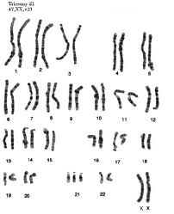
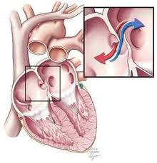
Congenital
Disease arises before birth
Inherited or caused
Ex: Down’s Syndrome, Congenital heart disease, fetal alcohol syndrome

Slide 15
Immunological
Reaction by body to an invasion by foreign substances.
Use of white blood cells (fight infection; create antibodies)
Body usually responds by inflammation (causes sore throat, pain from swollen tissue, coughing)
Foreign substances: bacteria, viruses, fungi, &/or protozoa
Ex.: allergies, common cold, HIV, pneumonia, AIDS

Slide 16
Metabolic
Disease that affects metabolism directly
(all diseases can eventually affect metabolism)
Production and use of energy is disturbed
No energy is made-other systems start to fail
Ex.: Diabetes, physical injury (trauma) which results in fluid loss that upsets metabolic balance b/w cells.
Start 2/12

Slide 17
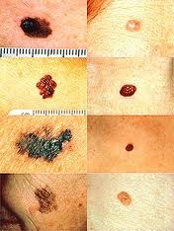
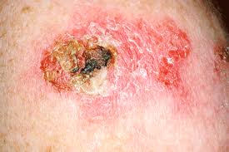
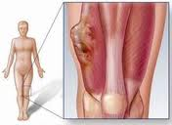
Neoplastic
Normal cells growth and reproduction become abnormal b/c cells develop lesions (tumor)
Threatens the normal activities of tissues and organs
Ex. Cysts, tumors
Benign – noncancerous ; malignant -- cancerous

Slide 18
Homeostasis
Feedback Loops

Slide 19
Homeostasis
Homeostasis is the ability of the body to maintain a relatively stable internal environment
The internal environment of the body is in a dynamic state of equilibrium [internal conditions vary, but within relatively narrow limits (ranges)]
A wide variety of chemical, thermal, and neural factors act and interact in complex ways to maintain homeostasis

Slide 20
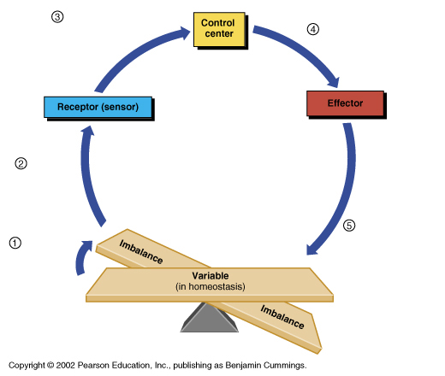
Homeostatic Control Mechanisms
Normal (Variable): the factor/event being regulated/altered
Receptor: monitors the enviro. and responds to changes (Stimuli)
Control center (c.c.): “boss” determines the set point at which the variable is maintained – gets info from receptor, gives info to effector
(ex: hypothalamus in brain)
Effector: provides the means to respond to the stimulus; signal sent out by control center

Slide 21
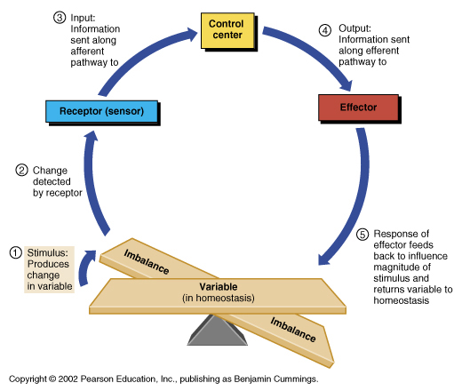
Homeostatic Control Mechanisms
Normal

Slide 22
Negative Feedback
Stimulus causes response to reverse the initial stimulus *opposite direction*
Most common type of feedback loop
Returns to homeostasis
Good for body
Ex: body temp reg./blood pres. reg./pH of blood/sodium of blood
Everyday occurrences with fxns of body
Restore body fxn to normal level
Notes:
Body temp → hypot

Slide 23
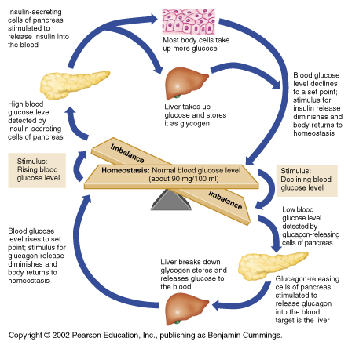
Negative Feedback
In negative feedback systems, the output “turns down” or “shuts off” the original stimulus
Example: Regulation of blood glucose levels

Slide 24
Positive Feedback
Stimulus causes response that supports, promotes, enhances or furthers
More rare
Does not restore a body fxn to normal level
“Vicious cycle” → harmful
Ex: heat stroke ; body temp.
Ex: childbirth and blood clotting *exceptions –

Slide 25
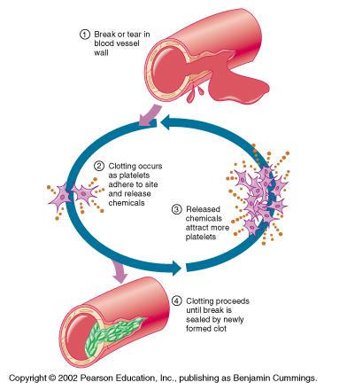
Positive Feedback
In positive feedback systems, the output enhances or “turns up” the original stimulus
Examples: Regulation of blood clotting, Uterine contractions during labor.

Slide 27
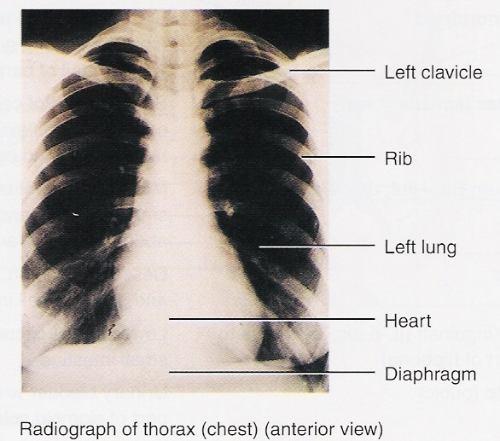
Medical Imaging
Allows physicians to peer inside the body to provide clues to abnormal anatomy and deviations from normal physiology in order to help diagnose disease
Examples?????
Conventional Radiography
(X-Ray)

Slide 28
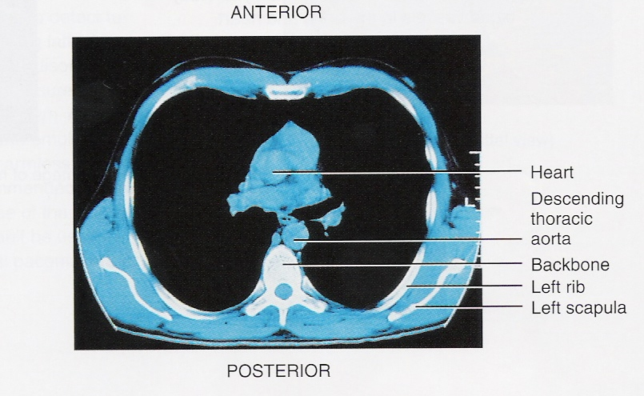
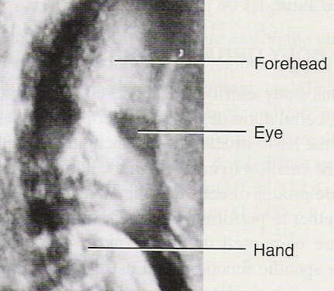
Medical Imaging
Computed Tomography (CT) Scanning
formerly called Computerized Axial Tomography (CAT) Scanning
Ultrasound

Slide 29
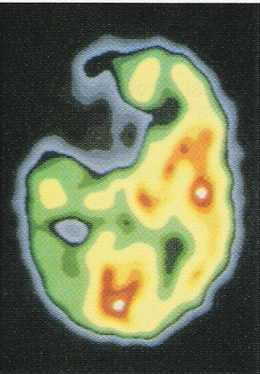
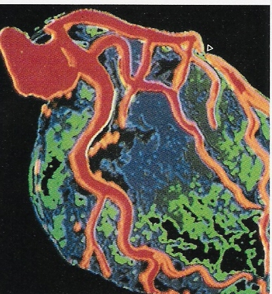
Medical Imaging
Anterior
Posterior
Positron Emission Tomography
(PET)
Digital Subtraction
Angiography
(DSA)
What happened here?

Slide 30
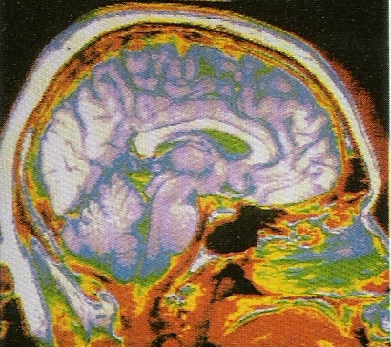
Medical Imaging
Magnetic Resonance Imaging (MRI)

Slide 32
Tissue Types
Each person at your table will research one tissue type. The
following information needs to be placed within your notes.
Assignments: 1. ID Tissue Type
#1: Epithelial 2. Definition of tissue
#2: Connective 3. Anatomy & Physiology of tissue
#3: Muscular 4. Specific examples within the body
#4: Nervous Ex: Blood is connective tissue
Ex: Bone is connective tissue
*Nervous: Be sure to include the 3 parts to all neurons. Draw a multipolar neuron, label the parts and list function of parts.
*All groups need to verbalize how the anatomy of the tissue dictates the tissue function and vice versa.

Slide 33
Levels of Organization
Tissue
Epithelial
Connective
Muscle
Nerve
This tissue forms the outer layer of skin, covers organs, lines cavities, and forms tubes, ducts, and portions of certain glands; responsible for protection, absorption, secretion, and excretion.

Slide 34
Levels of Organization
Tissue
Epithelial
Connective
Muscle
Nerve
Is the most abundant of tissue and is responsible for supporting organs of the body, providing sheaths for muscles, and connecting muscle to bones and bones to joints.

Slide 35
Levels of Organization
Tissue
Epithelial
Connective
Muscle
Nerve
Consists of three different types of tissue:
Voluntary or striated; skeletal
Cardiac
Involuntary or smooth

Slide 36
Levels of Organization
Tissue
Epithelial
Connective
Muscle
Nerve
Consists of nerve cells and interstitial tissue. It has the properties of excitability and conductivity, and functions to control and coordinate the activities of the body.

